Slide 1
Tackling the Non-communicable diseases In Somaliland.
Presented by: Dr. Ahmed Hersi( MD, Consultant Internist HGH)

Slide 2
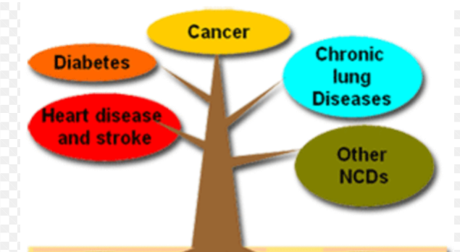
Non-Communicable Diseases (NCDs)

Slide 3
NCDs burden in Low-income countries
NCDs kill 41 million people yearly, equivalent to 74% of all deaths globally.
17 million people die from an NCD before age 70.
86% of these premature deaths occur in low- and middle-income countries.
Of all NCD deaths, 77% are in low- and middle-income countries.

Slide 4
NCDs burden in Low-income countries
Every second, 28 lives between the ages of 30 and 70 are killed by an NCD.
The countries that have not taken policy, legislative and regulatory measures to respond to the needs of people at risk of dying from NCDs.
25 of the 28 lives lost each second occur in low-middle-income countries,
where the social economics and physical environment afford the least protection from the risks and consequences of NCDs than the higher-income countries,

Slide 5
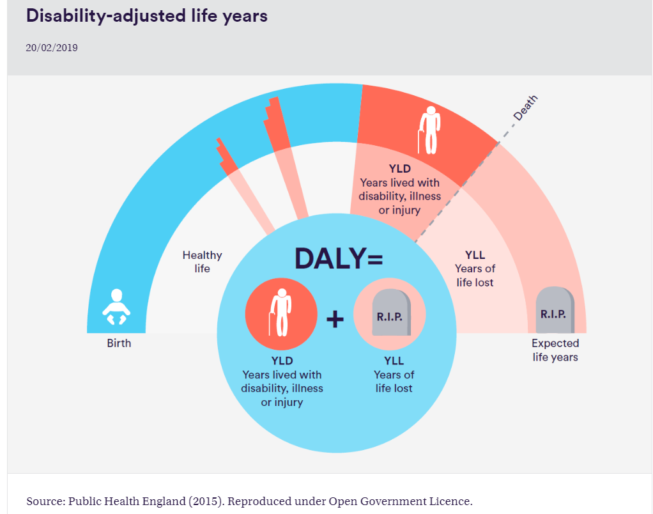
The disability-adjusted life year(DALY) measures the overall disease burden, expressed as the number of years lost due to ill health, disability, or early death.

Slide 6
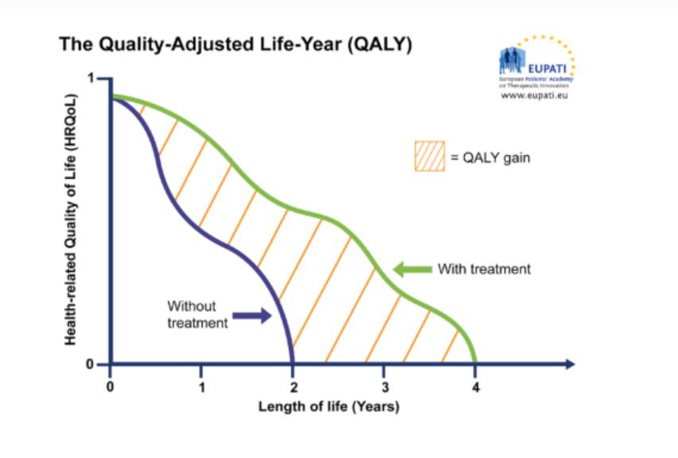

Slide 7
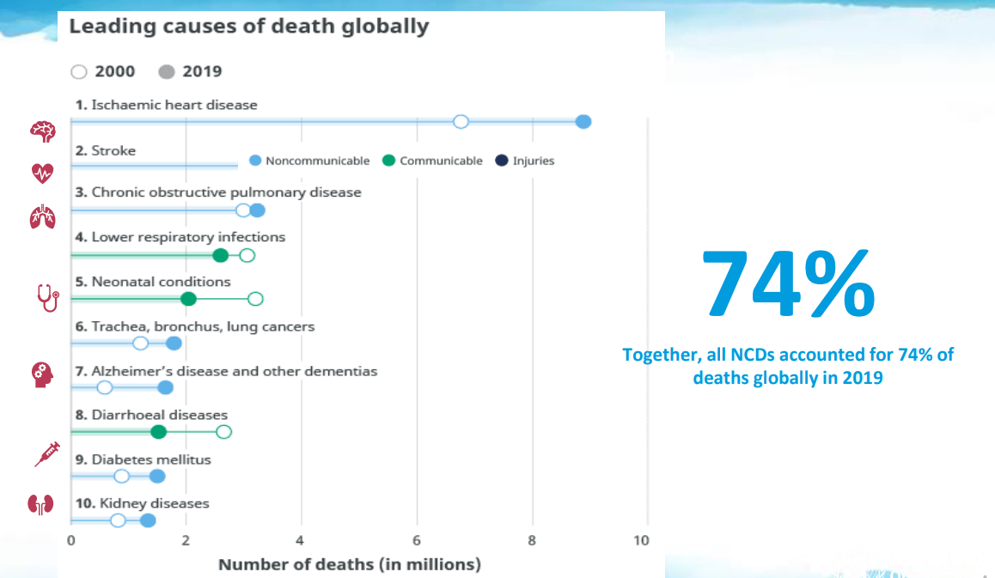

Slide 8
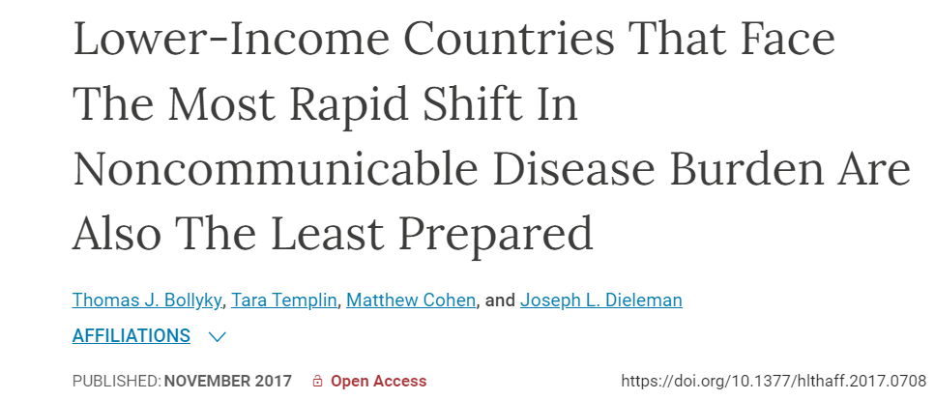
Changes in Demography/epidemiology enable a shift from communicable to NCDs in lower-income countries, although we have a double burden in Somaliland.
The health systems of lower-income countries are unprepared for this change

Slide 9
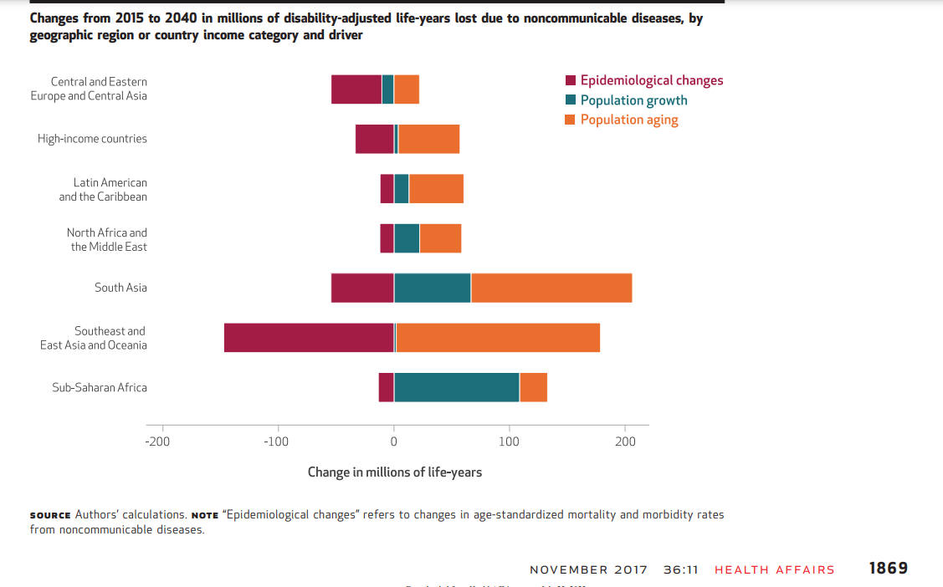

Slide 10
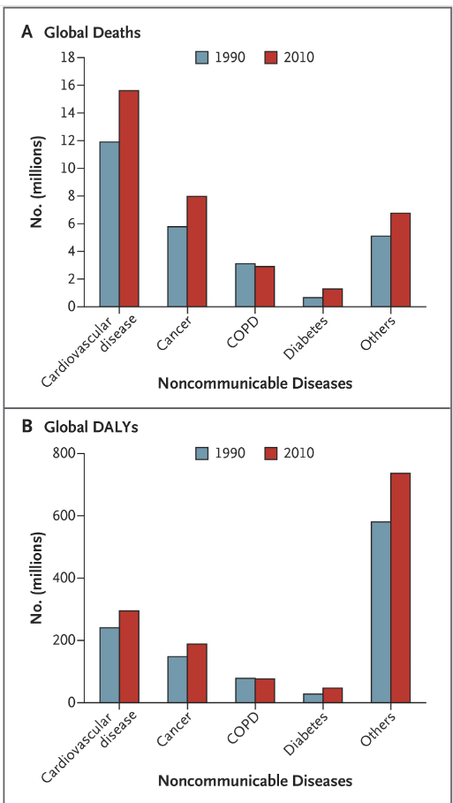

Slide 11
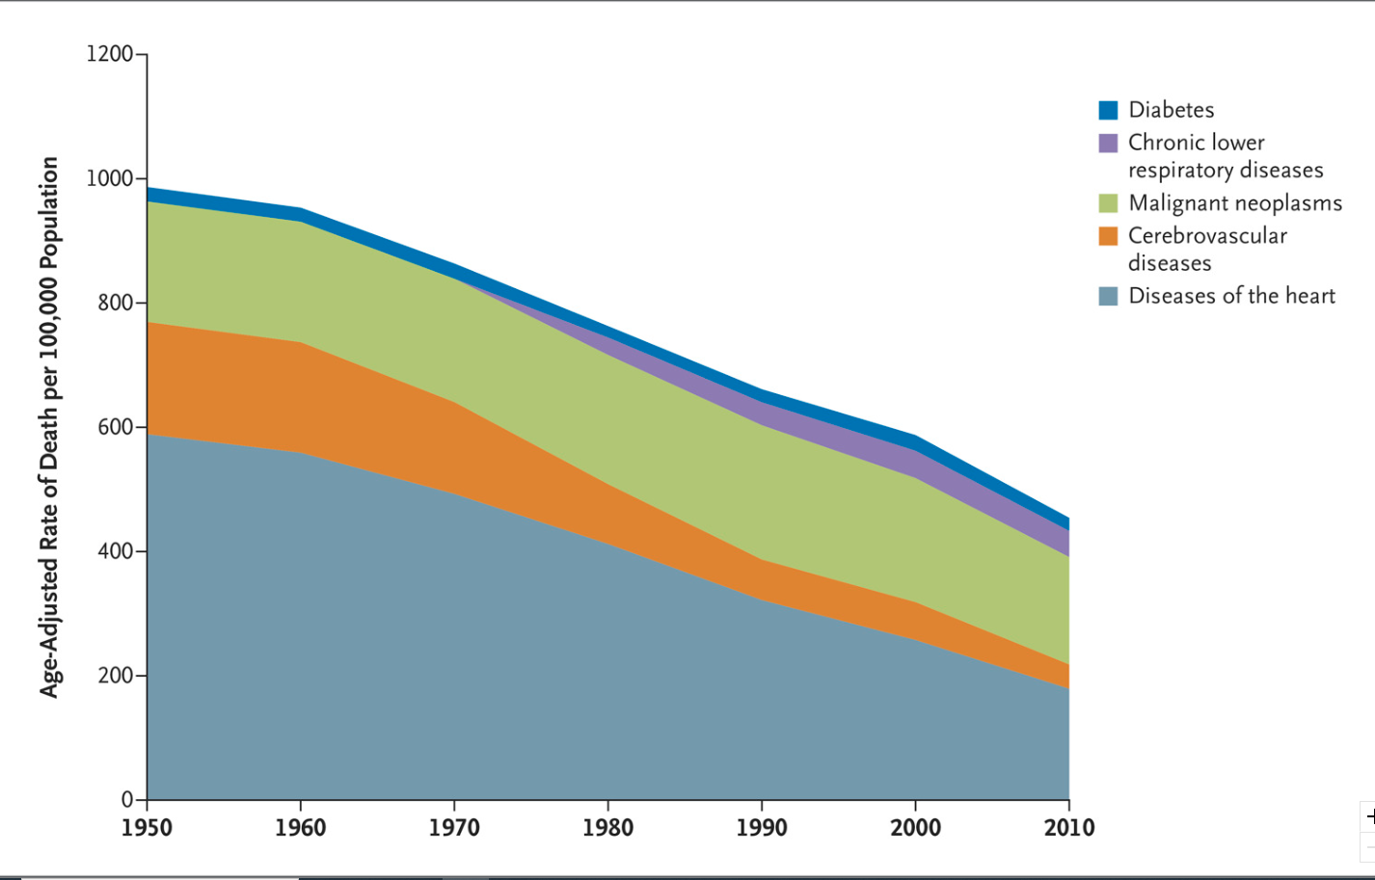

Slide 12
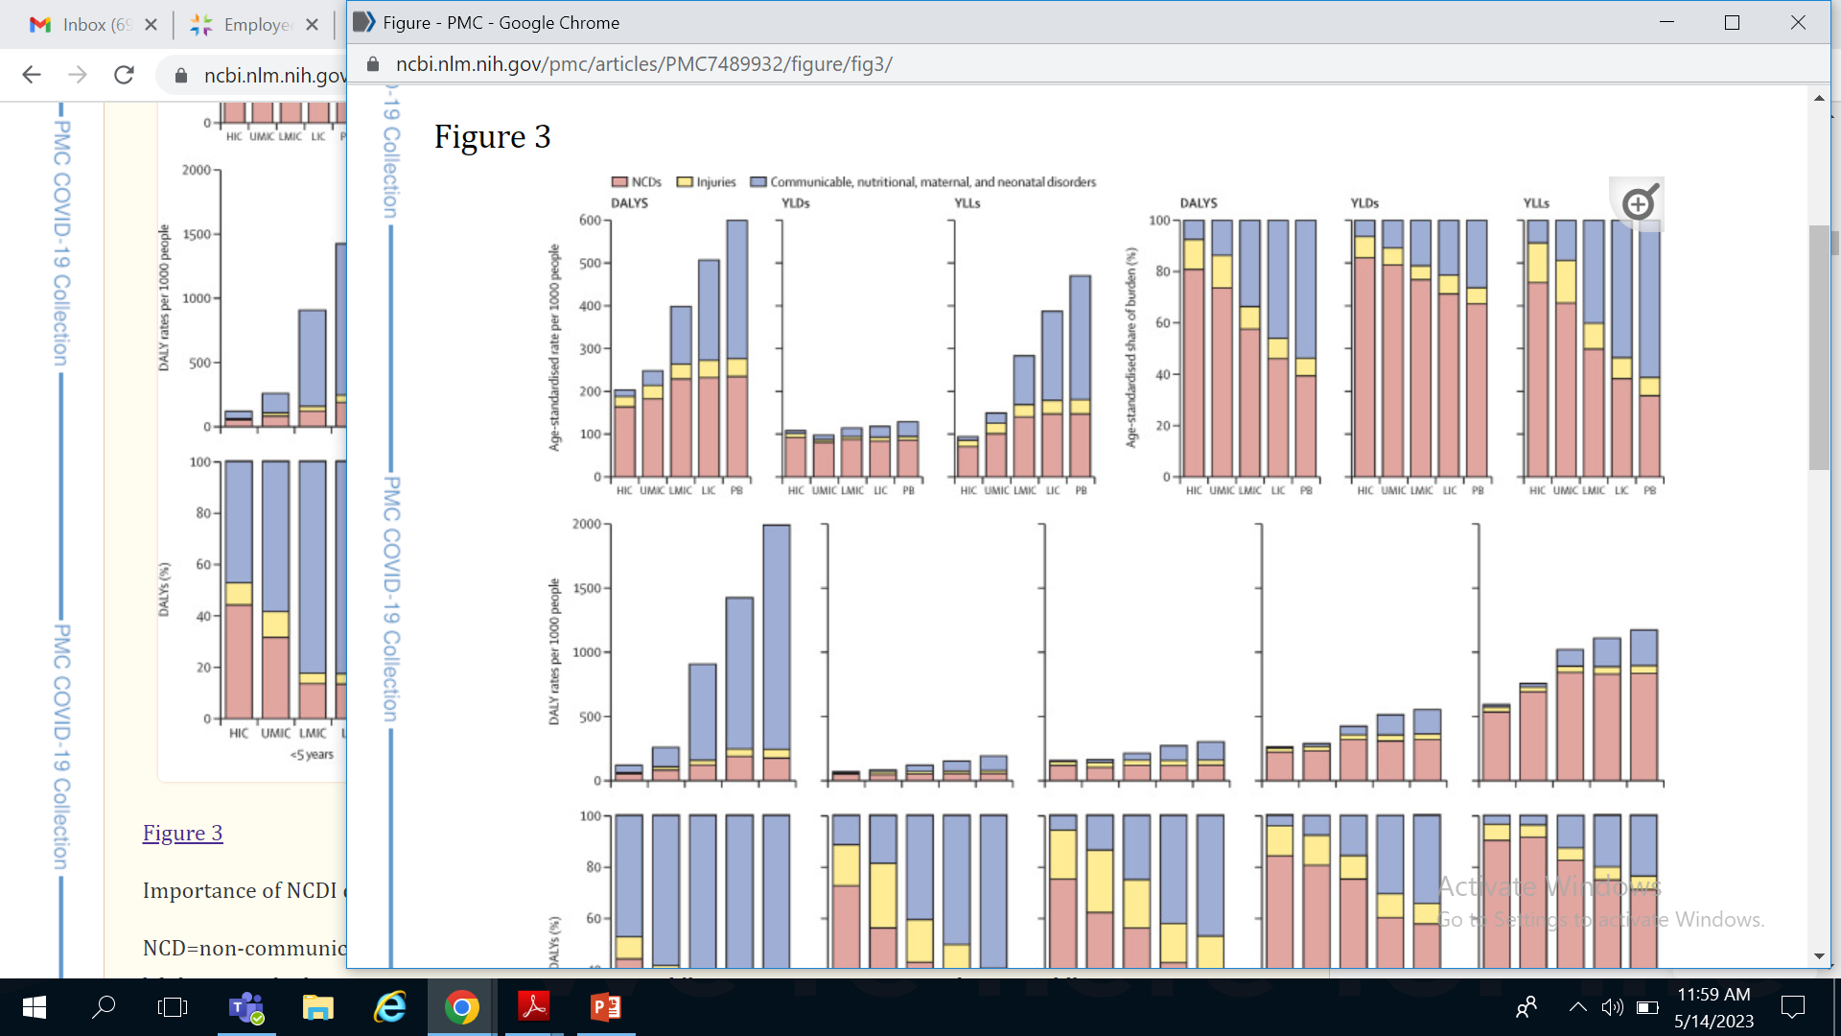
NCDs: Hypertension, COPD/asthma, Heart Failure, Diabetes
Notes:
Non communicable diseases and injuries (NCDI) account for more than a third of the disease burden for the poorest billion of our world accounting for almost 800,000 deaths for those aged 40 and younger annually. Between 19 and 50 million of the world’s poorest billion spend catastrophically on NCDI related care in direct out of pocket costs annually (11).
Years of life lost (YLL) is a measure of premature mortality that takes into account both the frequency of deaths and the age at which it occurs.
In addition, we found that rates of DALYs and years of life lost (YLLs) for NCDIs are higher at every age category among the poorest billion compared with full national populations in countries grouped by income level, even though they may constitute a smaller fraction of the burden among the most impoverished people (due to an even higher burden of communicable diseases and maternal and child death; figure 3). Tugwell and colleagues⁵⁸ have hypothesised that worse health among the poor can be explained through analysis based on the equity staircase model. This model posits that the poor face: higher risks of disease and mortality; lower financial or physical access to prevention, diagnosis, and treatment; and structural challenges that diminish the effectiveness of interventions. These structural challenges result in late diagnosis, lower treatment adherence, and make behavioural change less likely. Additionally, the quality of care provided to the poor is lower across a range of conditions. YLD = year of life w/ disability.

Slide 13
NCDs: Hypertension, COPD/asthma, Heart Failure, Diabetes
Notes:
Non communicable diseases and injuries (NCDI) account for more than a third of the disease burden for the poorest billion of our world accounting for almost 800,000 deaths for those aged 40 and younger annually. Between 19 and 50 million of the world’s poorest billion spend catastrophically on NCDI related care in direct out of pocket costs annually (11).
Years of life lost (YLL) is a measure of premature mortality that takes into account both the frequency of deaths and the age at which it occurs.
In addition, we found that rates of DALYs and years of life lost (YLLs) for NCDIs are higher at every age category among the poorest billion compared with full national populations in countries grouped by income level, even though they may constitute a smaller fraction of the burden among the most impoverished people (due to an even higher burden of communicable diseases and maternal and child death; figure 3). Tugwell and colleagues⁵⁸ have hypothesised that worse health among the poor can be explained through analysis based on the equity staircase model. This model posits that the poor face: higher risks of disease and mortality; lower financial or physical access to prevention, diagnosis, and treatment; and structural challenges that diminish the effectiveness of interventions. These structural challenges result in late diagnosis, lower treatment adherence, and make behavioural change less likely. Additionally, the quality of care provided to the poor is lower across a range of conditions. YLD = year of life w/ disability.

Slide 14
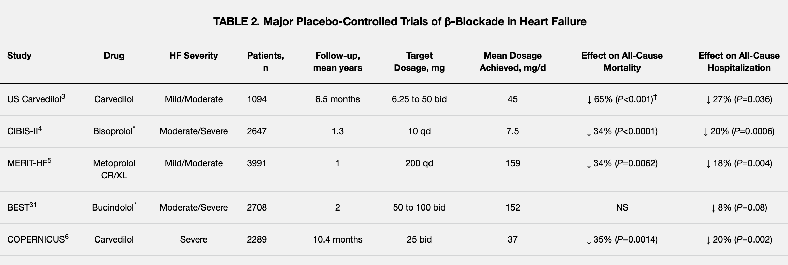
Mortality modifying medications for Heart failure (GDMT)
Beta blockers confer a 35% risk reduction of death in severe heart failure (COPERNICUS, 10.4 months)
Subsequent studies had similar and even higher findings
Gheorghiade et al. 2003; Waagstein et al. 1993 (MDC)
Notes:
These observations provide an opportunity to improve the quality of the care of patients with Heart failure in the region of SSA.

Slide 15
Hargeisa Group Hospital
Progress report on NCD Clinic

Slide 16
Brief History

Slide 17
HGH NCD clinic has been fully functioning since the end of 2022.
The clinic has been established by SAHA in collaboration with MOHD and HGH in December 1st 2022.
This was the first step of the initiative created by SAHA in response to the health needs of the country.

Slide 18
OBJECTIVES
1)To improve patient care and prevention of complications related to non-communicable diseases.
2) To conduct researches
3) To make HGH NCD Clinic as centre of training and sharing experience
4) To make fund raising from different stakeholders and provide free medications to the patients.

Slide 19
Vision and Mission
HGH NCD CLINIC

Slide 20
Vision
A country that is burdened by modifiable risk factors of non communicable/ chronic diseases.

Slide 21
Mission
Establish national capacity for prevention and control of NCDs led by MOHD of somaliland
Delivery of high-quality integrated health care
Provide appropriate treatment options
Promote health education and wellness of the community

Slide 22
THE CARE WE PROVIDE
HGH NCD CLINIC

Slide 23
Systematic; from the beginning to the end
Step 1; registration.
Step 2; evaluation of the patient.
a. History
b. examination
c. investigation
Step 3; counselling
Step 4; follow up.

Slide 24
Step 1; Registration
Different registration forms for different diseases.
Filled by the first visit of the patient

Slide 25
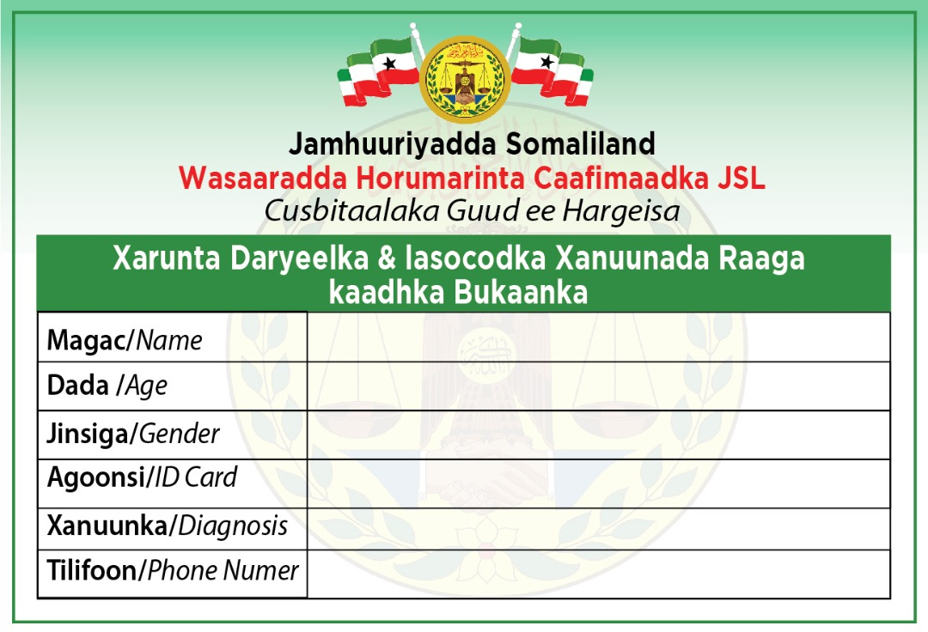
Step 1; Registration

Slide 26
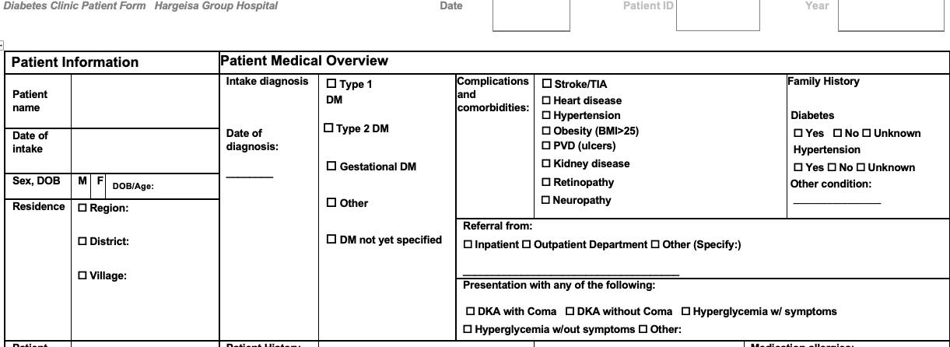
Patient intake form (Diabetes)
Notes:
Picture, example of patient f/u

Slide 27
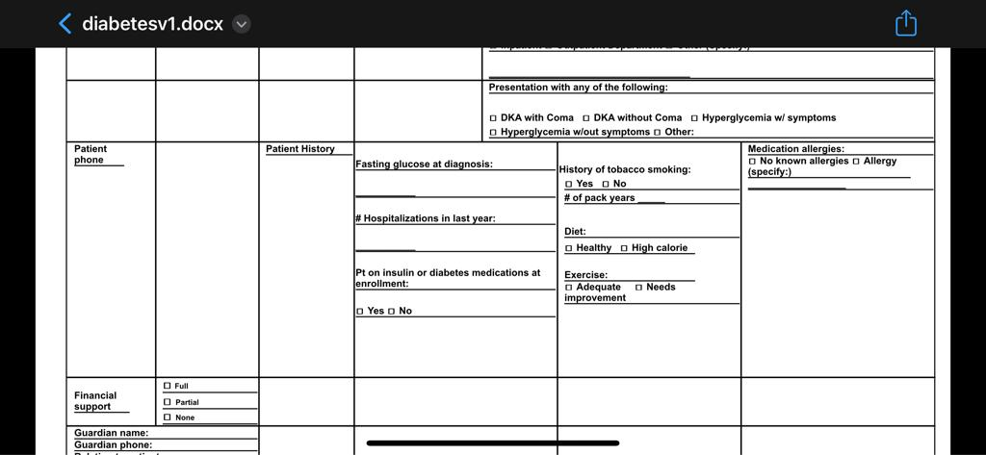
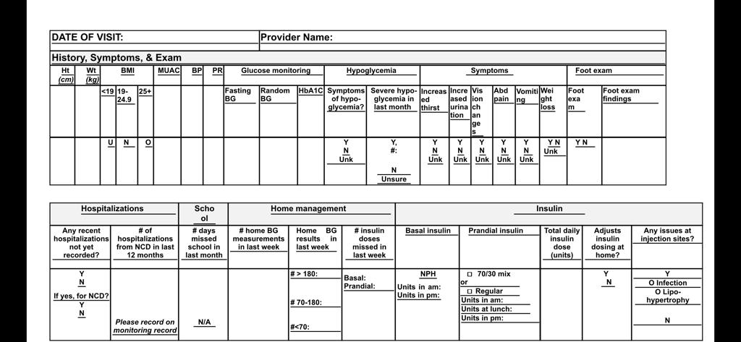

Slide 28
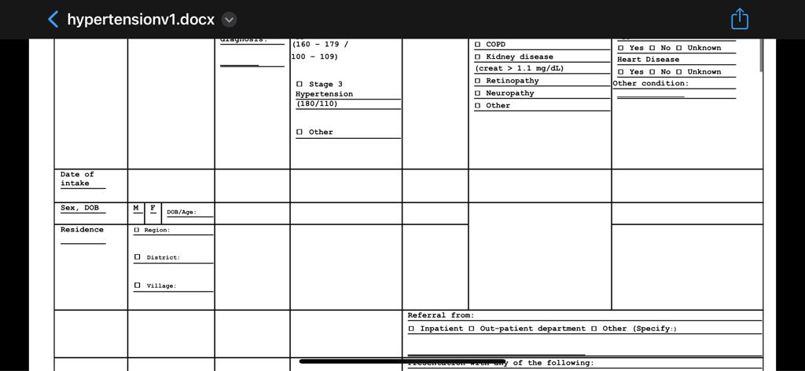
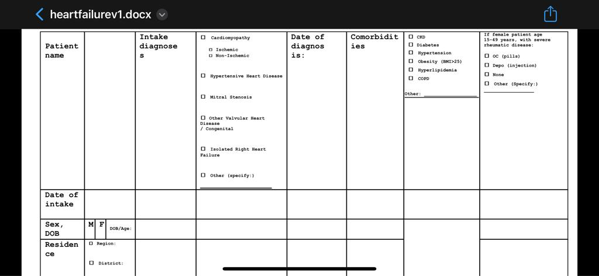

Slide 29
Step 2 ; evaluation of the patient
Focused clinical examination of the patient;
a. focused history
b. focused physical examination

Slide 30
Counselling
Diet and physical inactivity remains two major modifiable factors of NCD
Diet;
a. reduce sugar intake
b. reduction of carbohydrate intake.
Physical activity and exercise.
Specific complication; hypoglycemia(recognition and management)

Slide 31
Follow up
Disease specific.
Done weekly, every 2 week or monthly.
Home measurement are required;
a. random and fasting blood sugar.
b. blood pressure
echocardiogram for heart failure

Slide 32
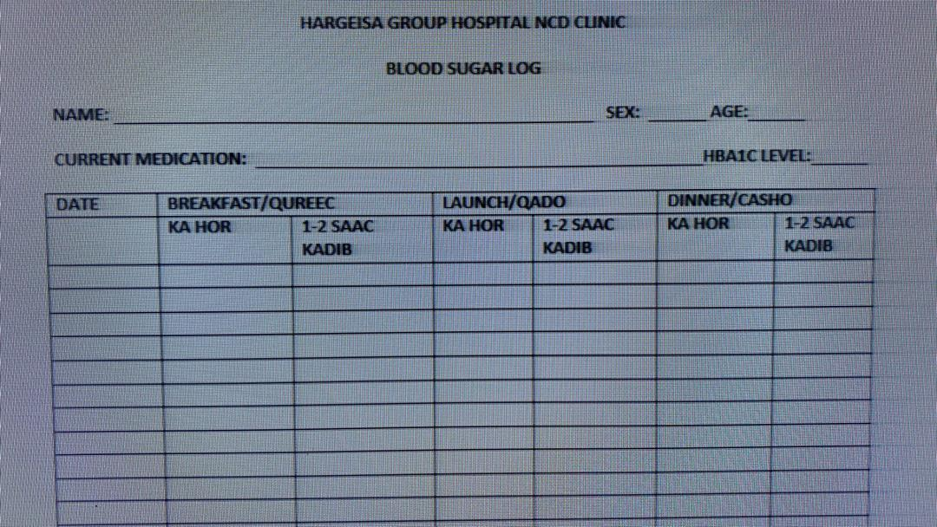

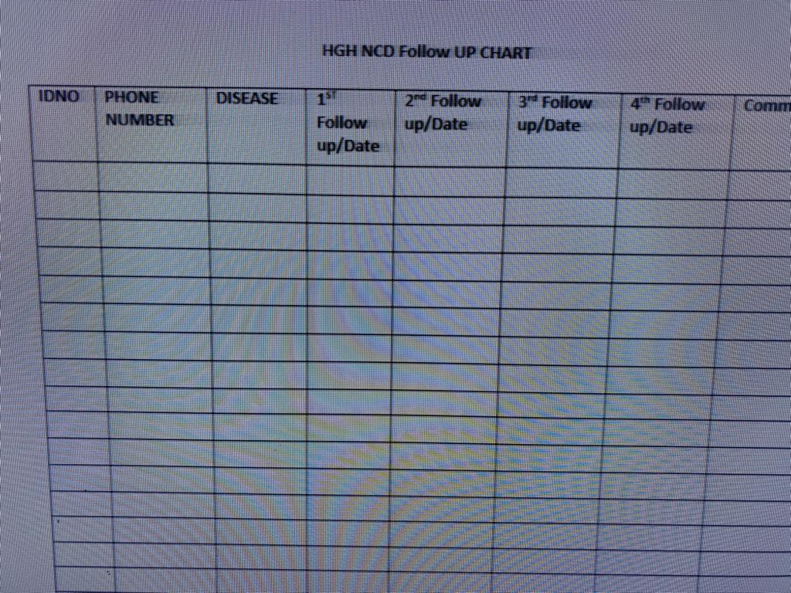

Slide 33
What makes us different?
HGH NCD CLINIC

Slide 34
Providing integrated evidenced-based treatment options to those diagnosed with NCDs in the most cost-effective way.
Providing social care for those who can not avoid;
a. medications
b. glucometer machines and strips.
Focusing the follow up to achieve appropriate glycemic targets, well controlled blood pressure.

Slide 35
At the moment !
HGH NCD CLINIC

Slide 36
Since the December 2022, more than 962 patients has been registered.

Slide 37
Distribution by Age and Diagnosis
 | AGE
 | 0-20 | 21-40 | >40 | TOTAL
DM (T1+T2) | 37 | 142 | 281 | 460
HTN | 0 | 12 | 79 | 91
CHF | 0 | 2 | 10 | 12
Asthma/COPD | 2 | 6 | 10 | 18
DM + HTN | 1 | 13 | 179 | 193
CHF+ HTN | 1 | 0 | 9 | 10
>2 diagnosis | 0 | 0 | 14 | 14
Total | 41 | 175 | 582 | 798
67.7% Female, 32.3% Male
Notes:
Probably should have a slide on follow up rate

Slide 39
Data Analysis
Since the December 2022, more than 800 patients has been done as data analysis.
Patients diagnosed with diabetes are 460 (57.8%); 306 (38.4%) are Female and 154 (19.3%) are Male.
Hypertensive patients are 91 (11.4%); 58 (7.2%) are Female and 33 (4.1%) are Male.
In total 193 (24.2%) have both diabetes and hypertension; 143 (18%) are Female and 50 (5%) are Male.
Number of patients with heart failure 32(4.2%); 18 (2.2%) are Female and 16 are Male

Slide 40
Gender
Female; 540(67.7%)
Male; 258 (32.3%)

Slide 41
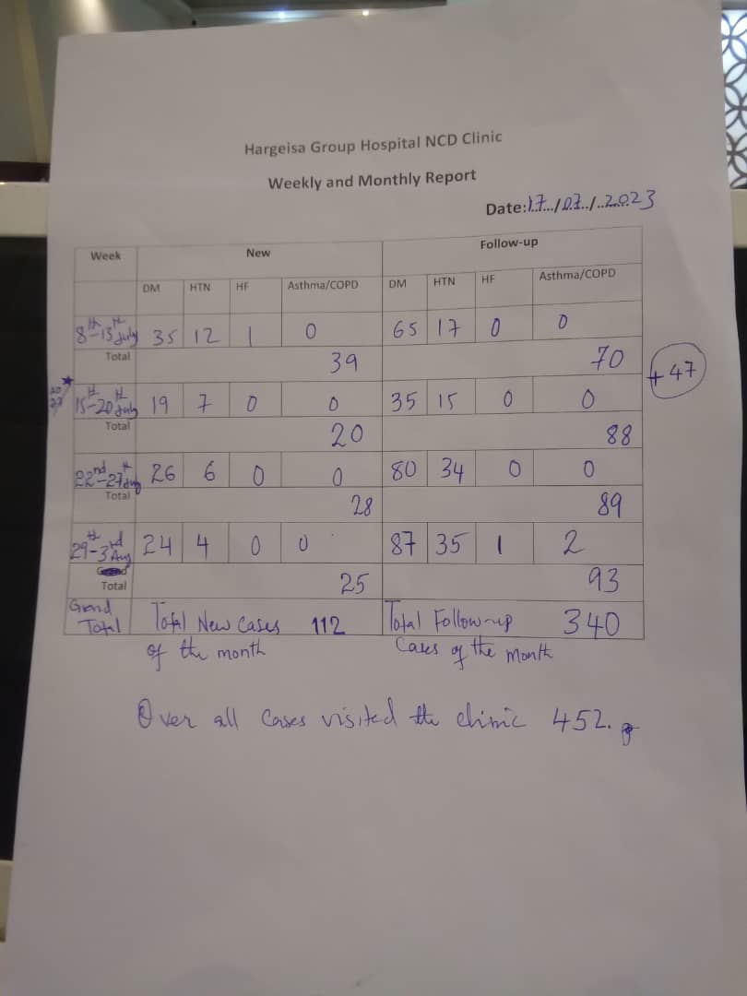
Fellow up rate

Slide 42
6th July to 3rd august, weekly report result
Total patient: 452
New Cases: 112 Cases
Diabetes (104)
Hypertension (29)
Heart Failure (1)
Asthma/COPD (0)
Follow up: 340 Cases
Diabetes (267)
Hypertension (101)
Heart Failure (1)
Asthma/COPD (2)

Slide 43
Challenges
Space
Follow up rate
Medication cost
Improving the education of working team and exposure to well established other NCD Clinics.

Slide 44
Space
Still we use one room inside the OPD department of HGH.
For the space, we are planning to get a new settlements for the up coming months/years with help of hospital administration and international friends.

Slide 45
Follow up
We experienced low rate of follow-ups for the first couple of months.
But now we established a way we preventing any patient lost through:
1. Weekly and monthly report.
2. Contact to the missed patients by phone call.

Slide 46
WHAT IS NEXT?
NCD CLINIC

Slide 47
In NCD clinic:
Improving follow up rates, including in the most uncontrolled patients DM (A1c>10%), HTN (SBP >160/110), decompensated heart failure, acute exacerbations of asthma/COPD.
Ongoing quality improvement and patient education.
Data analysis of follow up rates

Slide 48
Establish national capacity for prevention and control of NCDs led by the MOHD of Somaliland.

Slide 49
Thank you!

